Slide 1
Introduction to Electrical Circuits Final Term Lecture - 04
Faculty Name: Mr. A N M Shahebul Hasan
Email ID: shahebul@aiub.edu
Reference Book:
Introductory Circuit Analysis
Robert L. Boylestad, 11th Edition

Slide 2
Series Parallel Network Analysis
In general, when working with series-parallel ac networks, consider the following approach:
Redraw the network, using block impedances to combine obvious series and parallel elements, which will reduce the network to one that clearly reveals the fundamental structure of the system.
Study the problem and make a brief mental sketch of the overall approach you plan to use. Doing this may result in time- and energy-saving shortcuts.
After the overall approach has been determined, it is usually best to consider each branch involved in your method independently before tying them together in series-parallel combinations.
When you have arrived at a solution, check to see that it is reasonable by considering the magnitudes of the energy source and the elements in the circuit.

Slide 3

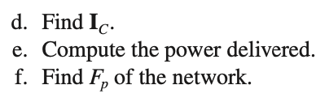

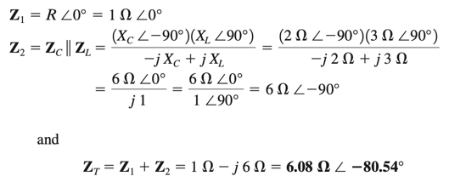

Example: For the network in following Fig. 16.1:
Solutions:
FIG. 16.1 Example 16.1.

Slide 4
FIG. 16.1 Example 16.1.

Slide 5
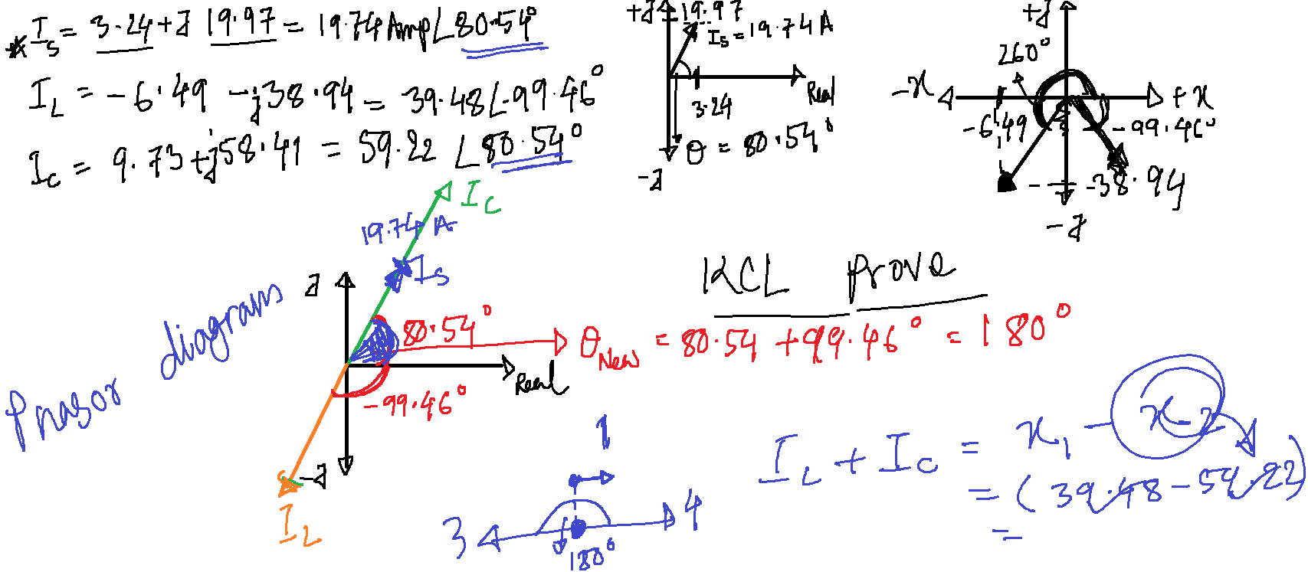

Slide 7
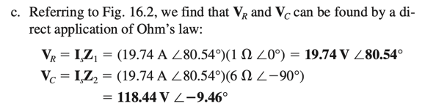
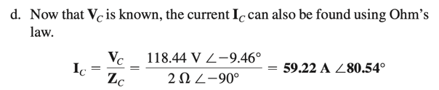

FIG. 16.1 Example 16.1.
FIG. 16.2 Network in Fig. 16.1 after assigning the block impedances.

Slide 8
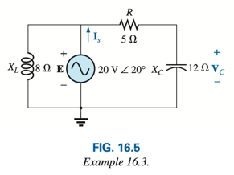

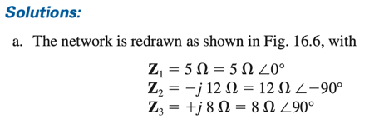

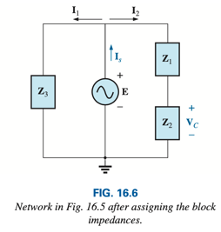
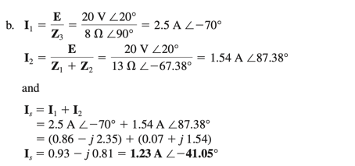
Example: For the network in following Fig. 16.5:

Slide 9
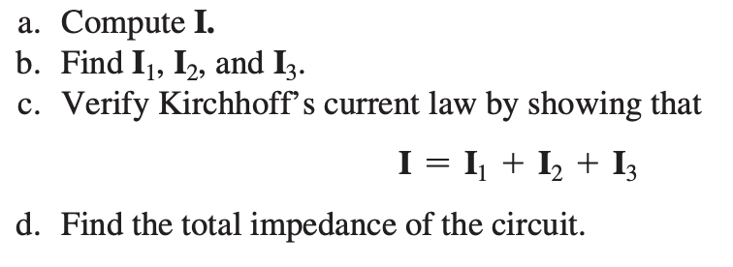
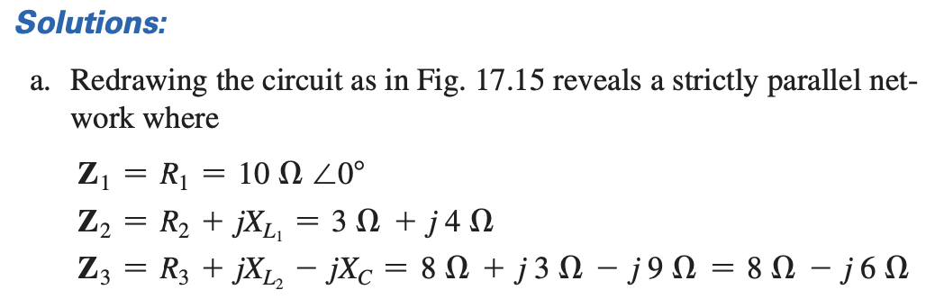
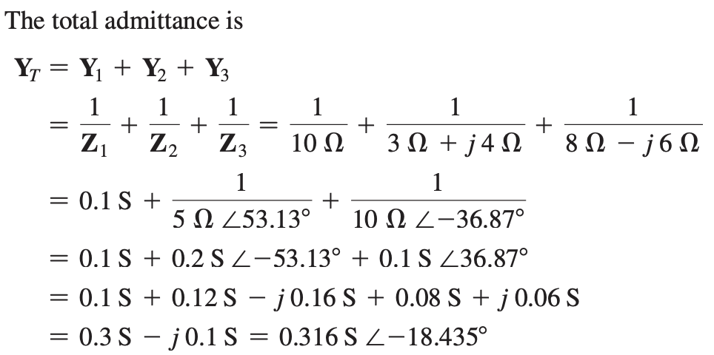
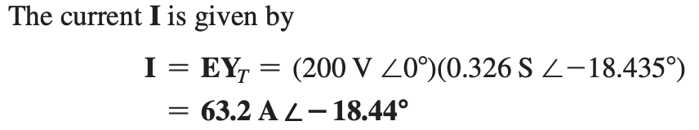
Example: For the network in following Figure:

Slide 10
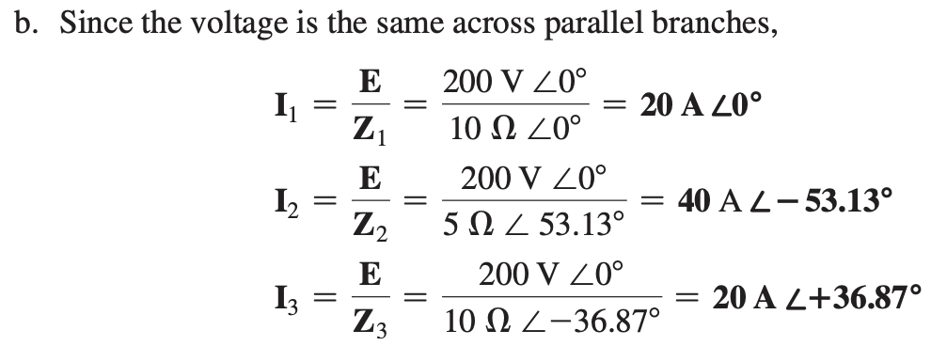
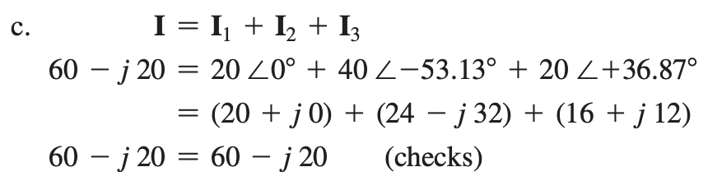
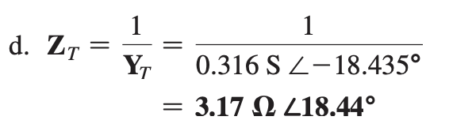

Slide 11
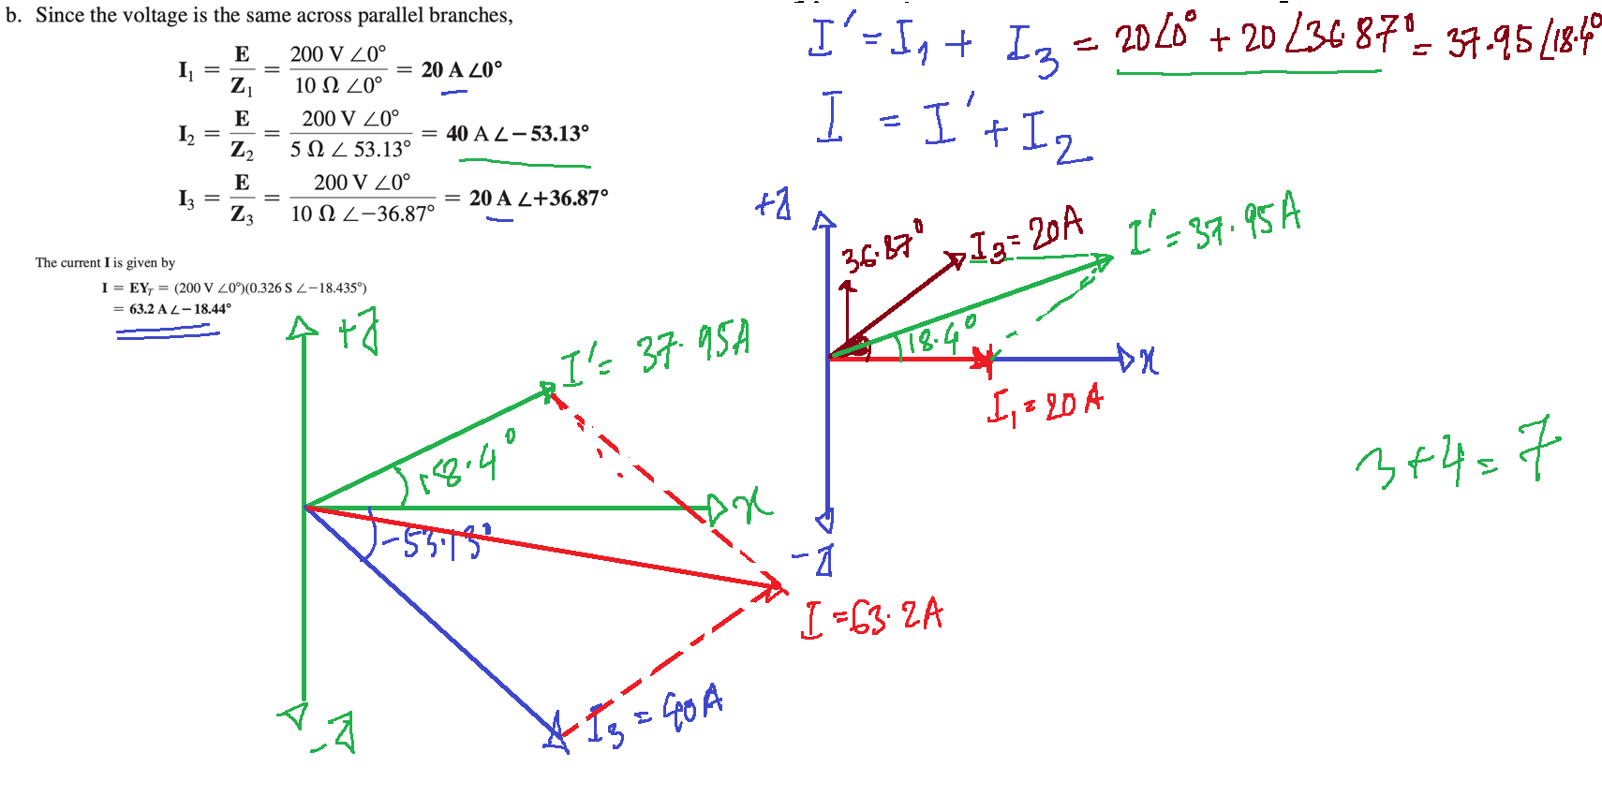

Slide 12
Thank You

